Slide 1
Smart Villages
Long term vision for rural areas
Franc Bogovič
Member of the European Parliament (SLS/EPP)

Slide 2
Why Smart Villages? Why Rural Agenda?
Why Long-term vision for rural areas?
Rural areas need a holistic vision to answer the challenges:
demographic changes
digital gap (connectivity, digital solutions, digital skills)
low income levels
limited access to services
climate change
COVID-19 crisis impact

Slide 3
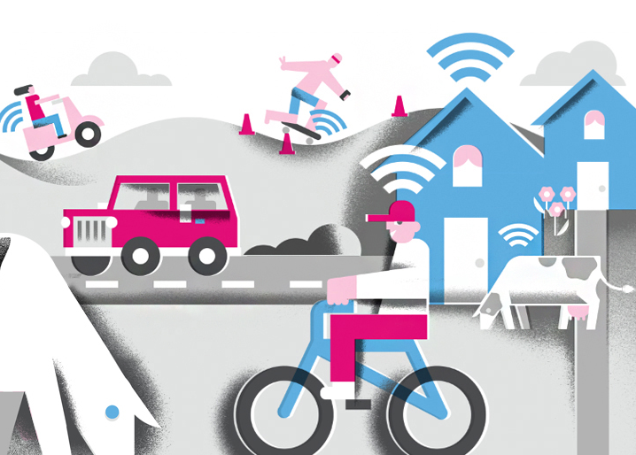
Smart Villages challenges/solutions
Smart villages for smart, attractive and
modern rural areas with:
A stable population (young people choosing to live in rural areas),
Quality of life and services comparable with urban areas,
Opportunities for business and new high value jobs,
Modern infrastructure (transport, environment, energy, schools, health & social services, shops, post offices, banks...)
Modern broadband connections, which are the basic pillar of digitalisation (5G, optics),
Resilient, green, and digital.
Smart Cities in EU = 200.000+ people
Smart Villages in EU = everything else

Slide 4
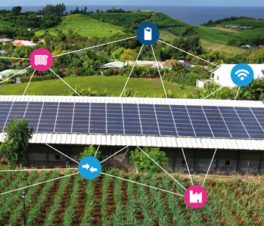
Smart Villages solutions
Agriculture: short food supply chains - connecting consumers and producers, precision farming, satellite sensing, automatisation (advanced sensors, smart resource management, robots, drones)...
Mobility: ride sharing, vehicle sharing, ride services for elderly, electric vehicles (personal, bikes), e-bike networks…
Economy: SMS in rural areas, bio based economy, digital platforms for local producers and companies, shared economy,...
Energy: decentralized energy, energy cooperatives, smart grids, home batteries, renewable energy sources...
Tourism: digital platforms for reservations, tourist cards, distributed hotels…
Social aspects: new job opportunities, long term care solutions, e-learning...
Health: telemedicine, body sensors...
Environment: reducing resources usage, reducing emissions...

Slide 5
COVID - 19 crisis lessons and Smart villages
A more resilient environment in a pandemic: from a health and mental perspective.
Local self-sufficiency gained in importance: food, energy, medical equipment ...
Increased interest in rural real estates, teleworking…
Poorer coverage with broadband connections (work, school, online shopping).
Bad infrastructure (transport possibilities, restrictions on movement to municipalities).
Lack of service capacity.
Weaknesses in the health care and elderly care

Slide 6

EU supports rural development
Commission President Ursula von der Leyen expressed that rural development is a priority (investment in broadband and high-tech solutions and services).
Commissioner Dubravka Šuica, Vice-President of the European Commission prepared the Long term Vision for EU’s Rural Areas.
The goal of making Europe green, digital and resilient cannot be achieved without green, digital and resilient European rural areas!

Slide 7

A long term Vision for
EU’s Rural Areas
Towards stronger, connected, resilient and prosperous rural areas by 2040

Slide 8

Rural pact
The Rural Pact will provide a common framework for the engagement and cooperation of a wide range of actors at the EU, national, regional and local level.

Slide 9
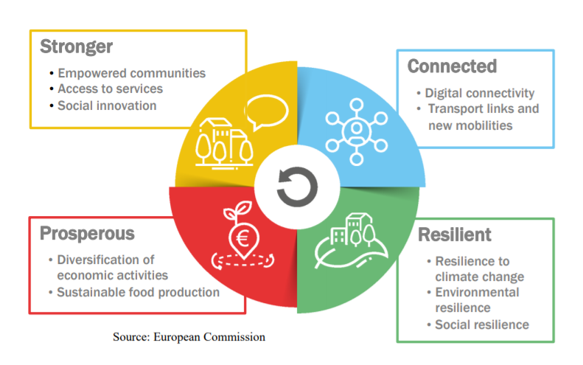
EU Rural Action Plan
4 areas of action
Rural Action Plan will be build upon around flagship initiatives EU policies, which provide support to address rural challenges and opportunities and contribute to the balanced, fair, green and innovative development of rural areas.

Slide 10

Flagship initiatives supporting stronger rural areas
Building on existing and future local development strategies,
enhanced networking should help provide more advice to local
communities, notably on access to funding and the conception of
such strategies. The Smart Villages approach will also continue to be
promoted in this context.
Rural revitalisation platform
The Commission will set-up a one-stop shop platform for information on existing projects and funding possibilities for rural communities, rural project holders and local authorities alike to collaborate
Research and innovation for rural communities
Rural-focused R&I activities under Horizon Europe will support the development of innovations by and for rural communities, training, as well as knowledge exchange between the actors of rural innovation

Slide 11

Flagship initiatives encouraging connected rural areas
Development of sustainable rural mobility strategies,
widespread digital literacy and connectivity.
Sustainable multimodal mobility best practices for rural areas
‘Rural Digital Futures’

Slide 12

Flagship initiatives supporting resilient rural areas
Increasing the environmental, climatic and social
resilience of rural areas.
Support rural municipalities in energy transition and
fighting climate change
Climate action in peatland through carbon farming
The proposed EU Mission on soil health and food
Social resilience and Women in rural areas

Slide 13

Flagship initiatives promoting prosperous rural areas
Actions in this field should contribute to the economic diversification in rural areas around the green and digital transformation of society and lead to the strengthening of value chains in manufacturing and in cultural and creative industries.
Entrepreneurship and social economy in rural areas

Slide 14
EU strategic policies/funds for Smart villages
European Agriculture guarantee fund (EAGF) - 258.600 million
Rural Development Program (RDP) 85.350 million
Strategies for Smart Villages - Strategic plan(CAP)
Investments in digital technologies, promote digitalisation and innovation,
Business development, social inclusion and employment in rural areas,
Generation renewal
LEADER initiative
Cohesion policy - 403.000 million
European regional development fund (ERDF) - 200.000 million
European social fund(ESF) - 88.000 million
Cohesion fund - 42.000 million
React EU - 47.500 million
Just Transitional fund(JTF) - 17.500 million
European territorial cooperation (INTERREG - 7.950 million

Slide 15
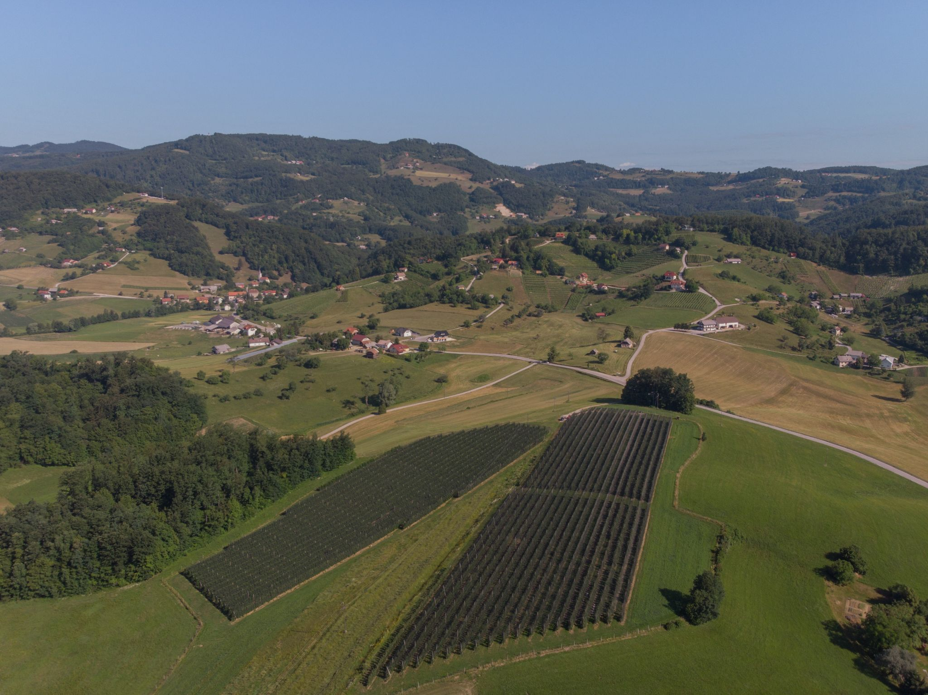
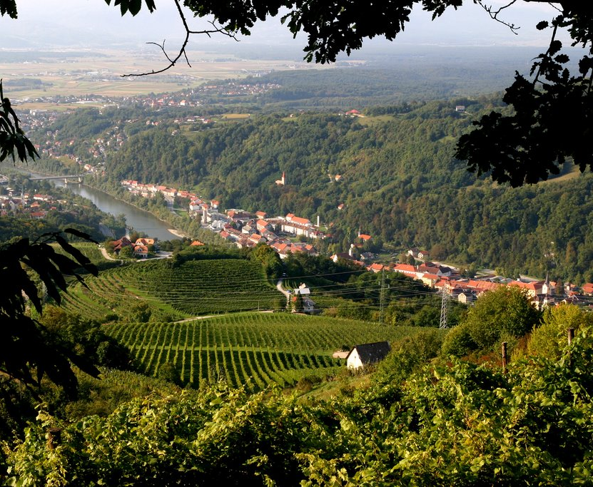
Living in the countryside must become a privilege!

